Slide 1
KYRGYZ CULTURE
IN THE MID 19TH –
EARLY 20TH CENTURIES
Cholpon CHOTAEVA
Anthropology, AUCA

Slide 2
Contents
General information
Housing
Clothing
Food and tableware
Rites
Epic
Akyns
Written culture
Research

Slide 3
General information
The period of annexation of Kyrgyzstan by the Russian Empire
Culture followed general trends
New trends in culture developed
Revival of Kyrgyz culture

Slide 4
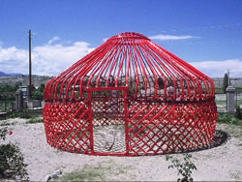
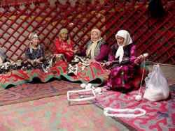
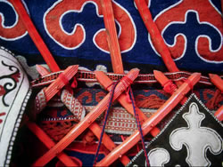
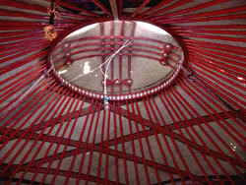
Housing
Yurts – portable houses
Elements:
Vertical sticks – kerege
Wooden poles – uuk
A smoke duct - tyunduk
Hearth - kolomto
Threshold - bosogo

Slide 5
Housing
Stationary houses
(built by Russians and followed by Kyrgyzs)
Elements:
Houses made of mud bricks
Big windows
Roof
Porch with steps

Slide 6
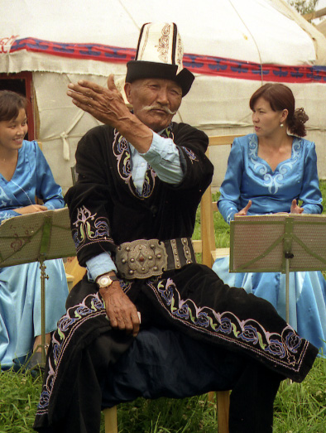
Clothing
Traditional
(made from felt and furs mainly)
Long shirt– koynok
Troushers – dambal, shym
Cloak - chepken
European-style
(worn by Rusians, Ukrainians, Tatars and made from various fabrics)

Slide 7
Food and tableware
Food:
Cereals
Vegetables
Fruits
Tableware:
Made from wood
Made from leather
Ceramic

Slide 8
Rites
Calendar rites (Nooruz, Orozo Ait, Kurman Ait)
Rites of passage (birth, marriage, death)

Slide 9
Epic
“Big epic” (Manas, Semetei, Seitek)
Heroic
Manaschys – Manas reciters: Balyk, Keldibek, Tynybek, Sagymbai, Sayakbai
“Small epic” (30 epics):
Heroic (Janyl Myrza, Kurmanbek)
Nature (Kojojash)
Fantastic (Er Tyoshtyuk)

Slide 10
Akyns
Akyn – musician, composer, poet, improviser
Akyns:
Zamanists: Kalygul, Arstanbek (Tar Zaman)
Democrats: Toktogul, Togolok Moldo

Slide 11
Written culture
Chagatai script based on Arabic
Moldo – the person who could read and write in Chagatai
Writing akyns and thinkers:
Moldo Niyaz (“Sanat yrlary”)
Togolok Moldo (akyn and manaschi)
Moldo Kylych (“Zilzala” published in Kazan)

Slide 12
Research
Kyrgyz writing historians:
Osmonaly Sydyk uulu (“Mukhtasar tarykh kyrgyziyya, Tarykh kyrgyz Shadmaniya”)
Belek Soltonoev (“Kyrgyz-kazak tarykhy”)

Slide 13
Research
Chokan Valikhanov (geography, folklore, history)
Semenov-Tyanshanskiy (Tien Shan Mountains)
Przhevalskiy (geographer, zoologist, biologist)
Radlov (Manas epic, 14 000 lines recorded)
Barthold (history)

Slide 14
Conclusion
Following the colonization of Kyrgyzstan by the Russian Empire a large-scaled research of its history, geography, culture, nature took place

